Slide 1
CIPRES Walkthrough

Slide 2
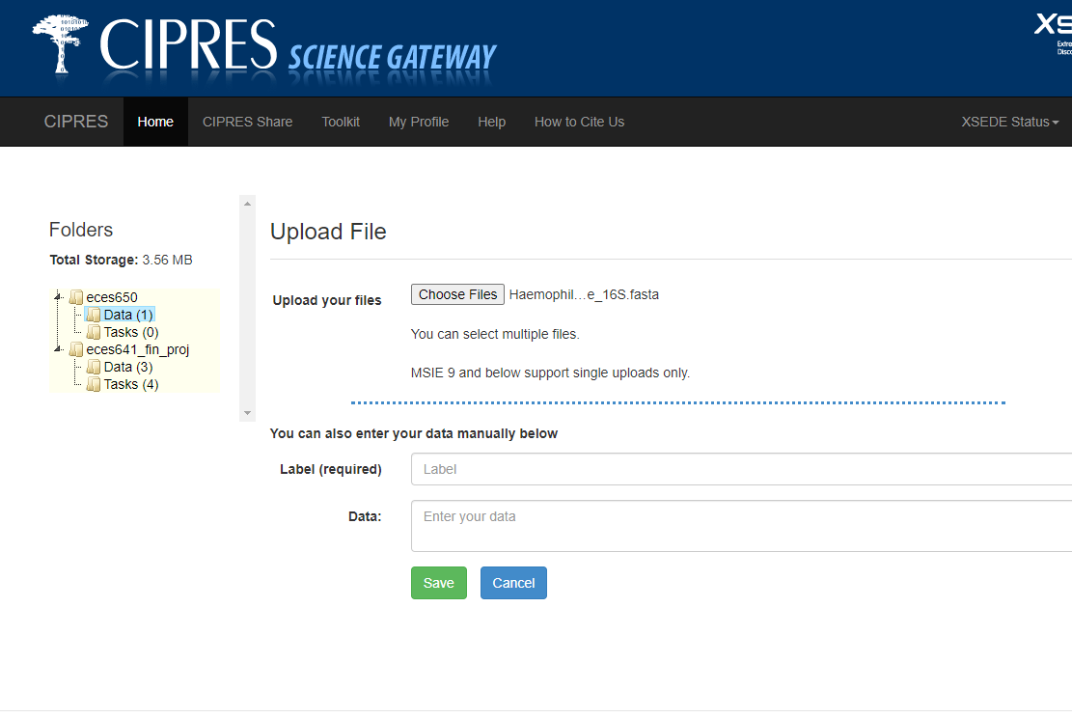
Uploading Our Data

Slide 3
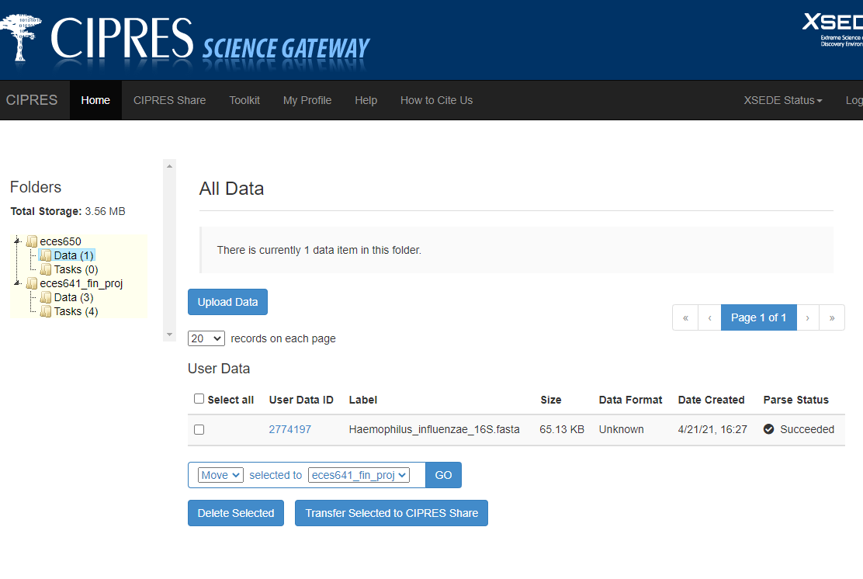
Viewing Our Uploaded Data

Slide 4
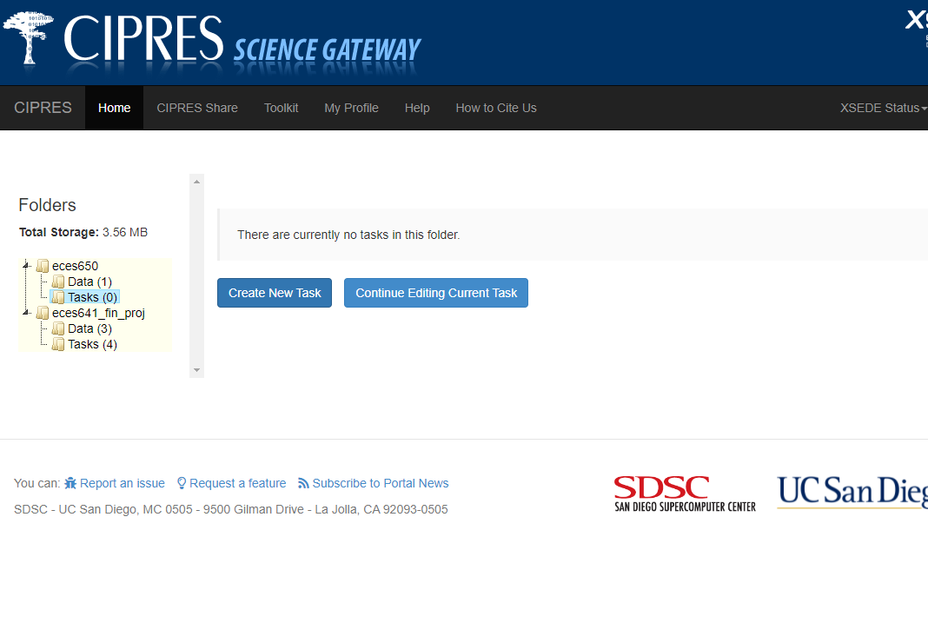
Creating a New Task

Slide 5
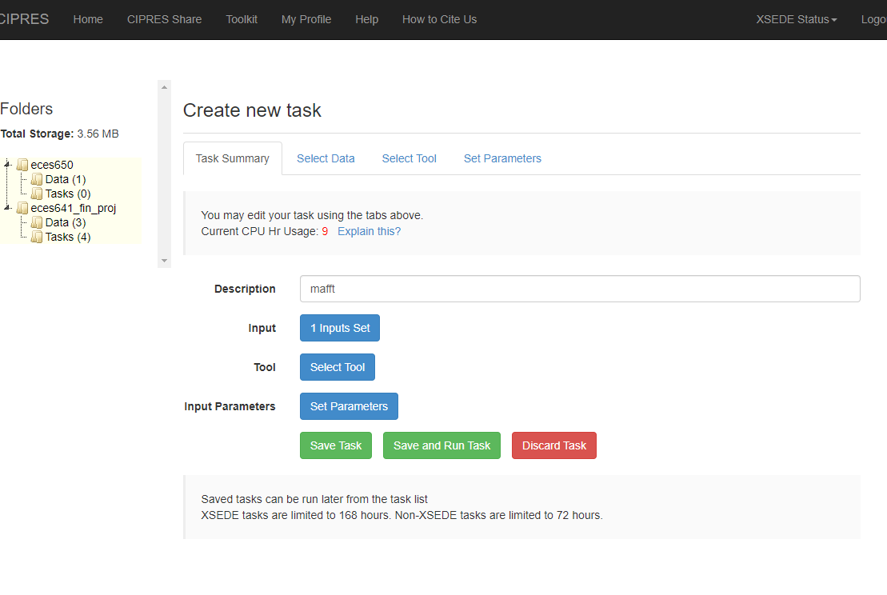
New Task: Task Summary

Slide 6
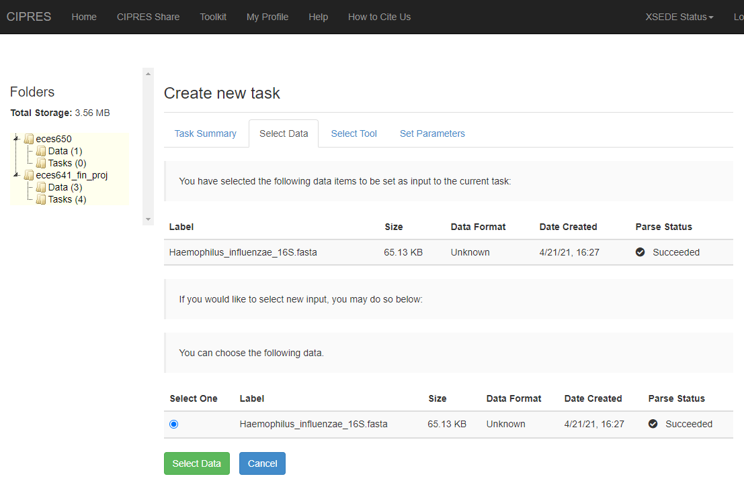
New Task: Select Data

Slide 7
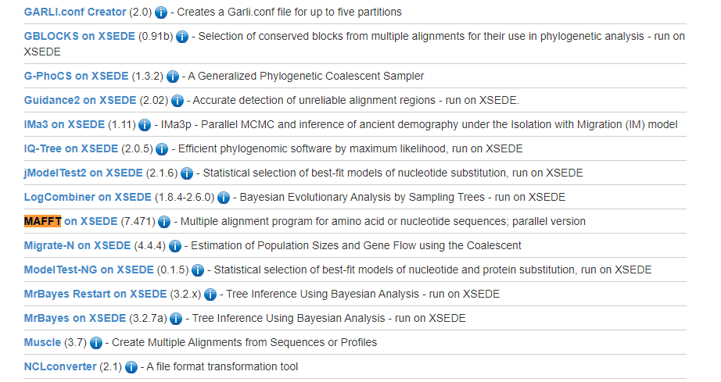
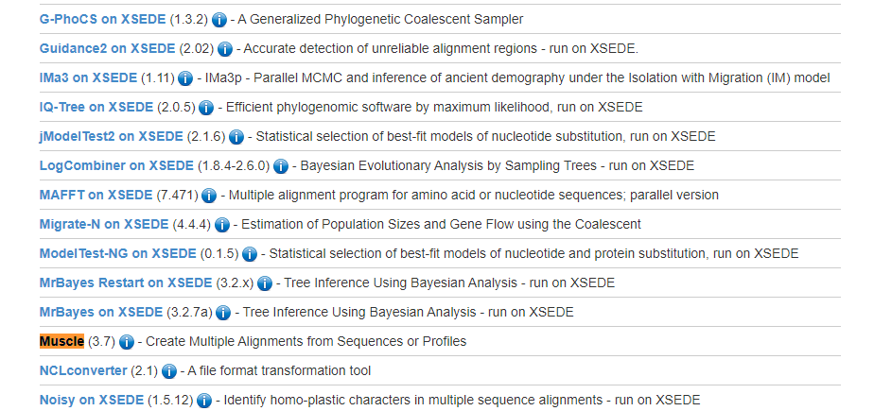
New Task: Select Tool

Slide 8
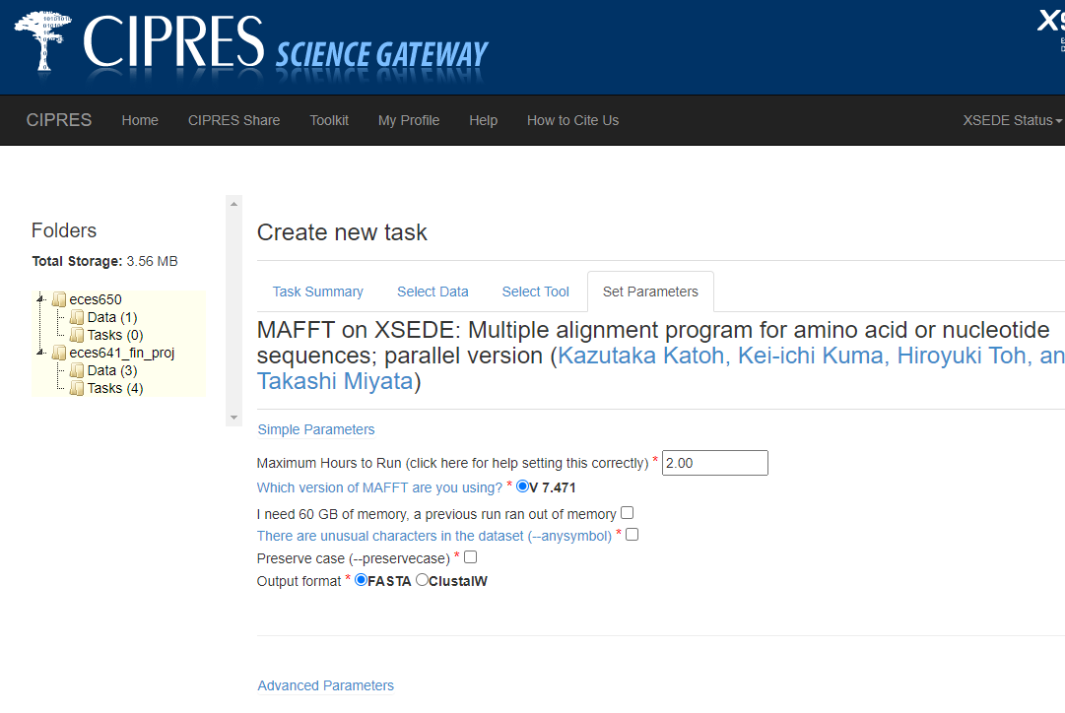
New Task: Set Parameters (only if necessary)

Slide 9
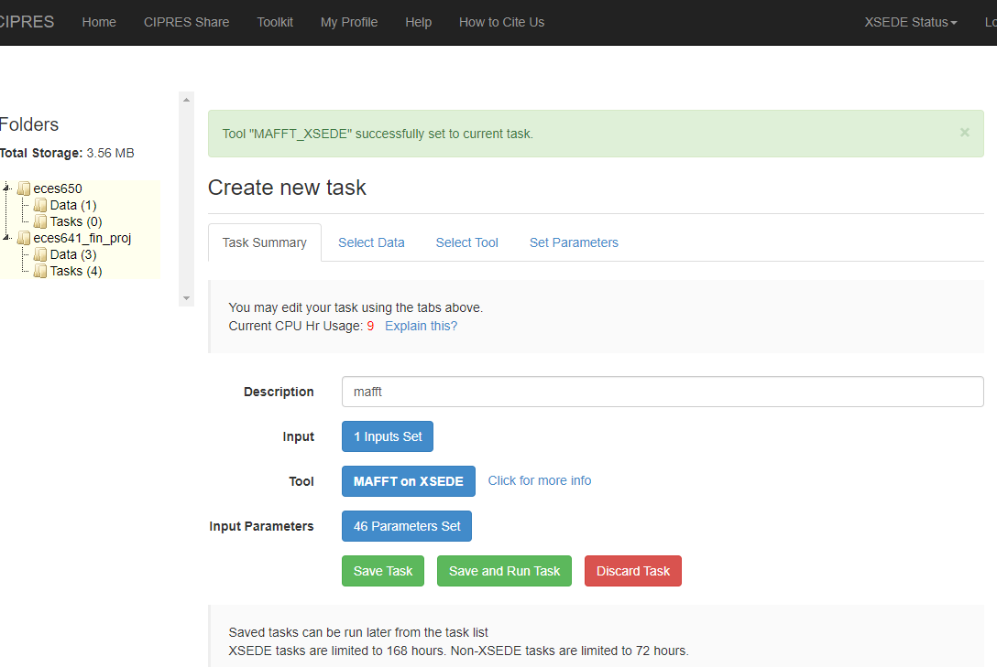
New Task: Save and Run Task

Slide 10
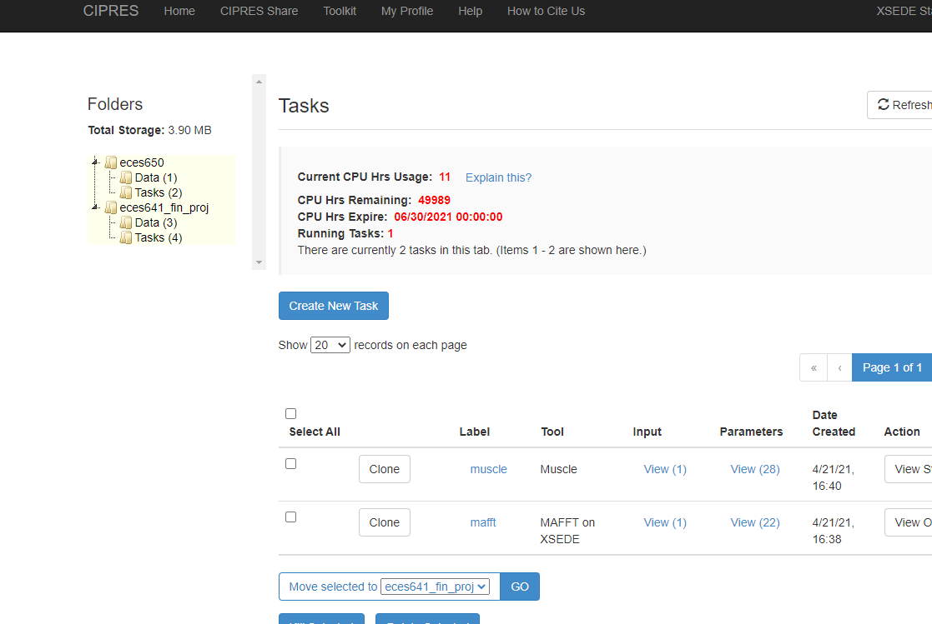
View All Tasks

Slide 11
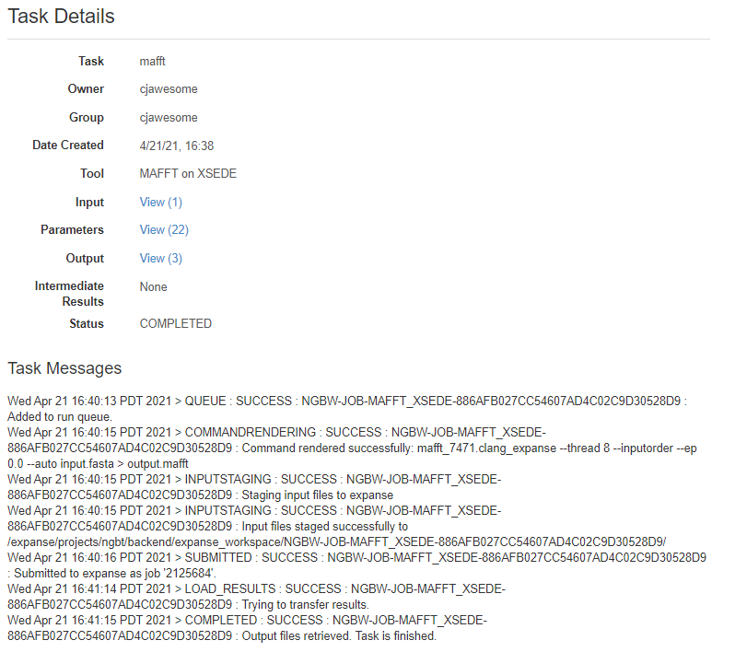
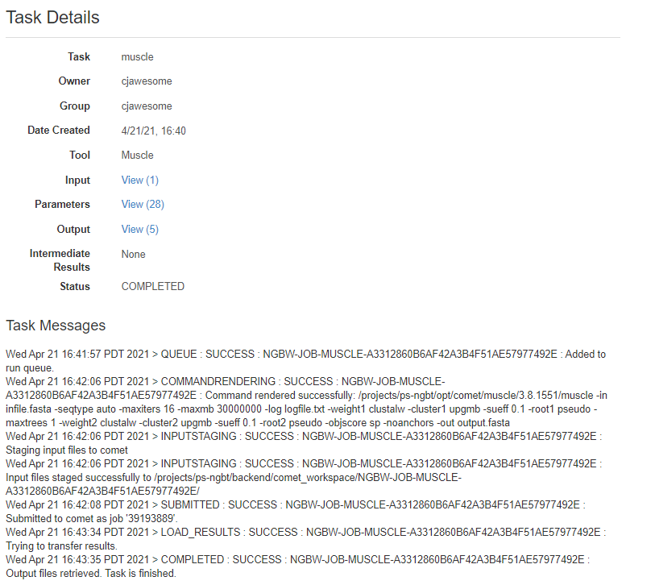
Task Completion

Slide 12
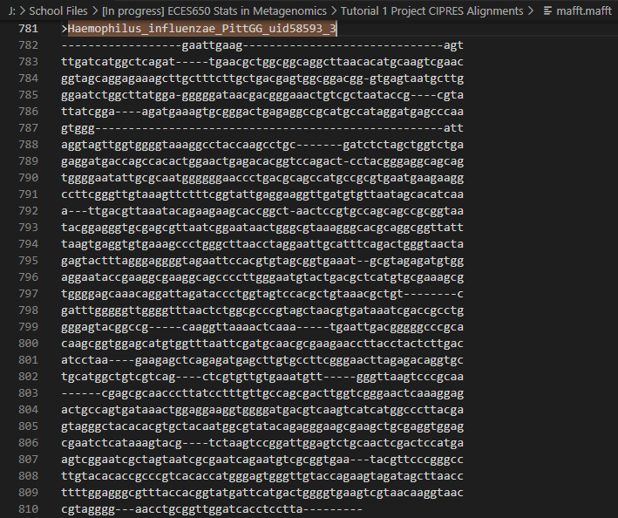
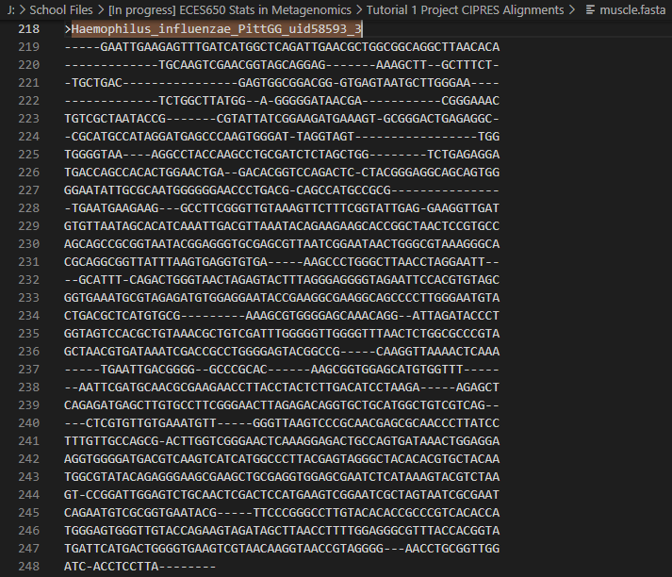
Output: MAFFT v. Muscle

Slide 13
References
Miller, M.A., Pfeiffer, W., and Schwartz, T. (2010) "Creating the CIPRES Science Gateway for inference of large phylogenetic trees" in Proceedings of the Gateway Computing Environments Workshop (GCE), 14 Nov. 2010, New Orleans, LA pp 1 - 8.

